Slide 1

Agentic RAG Chatbot
for
Multi-Format Document QA

Slide 2
Introduction
This presentation provides a comprehensive overview of the Agentic RAG Chatbot, an intelligent system designed for semantic question answering across a variety of document formats, including PDF, Word, and PowerPoint files.
The chatbot is built on an agent-based architecture enhanced by a custom Model Context Protocol (MCP), allowing it to break down complex tasks into modular components (agents) such as document ingestion, retrieval, and response generation.
By leveraging retrieval-augmented generation (RAG) and powerful NLP models, the chatbot can extract meaningful context from documents and deliver accurate, human-like answers to user queries. This makes it highly suitable for document analysis, customer support, and knowledge management use cases.

Slide 3
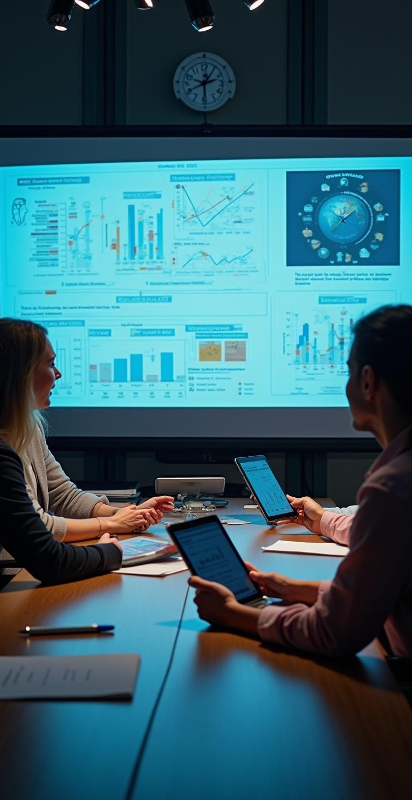
Project Overview
01
Subtitle: Semantic Document Q&A using Agent-Based Architecture and Model Context Protocol (MCP)
Key Highlights:
✅ Supports semantic question-answering over user-uploaded documents: PDF, PPTX, CSV, DOCX, TXT, and Markdown
🧠 Built on a modular agent design: Ingestion, Retrieval, and LLM Response agents
💡 Uses a local, open-source LLM from Hugging Face (flan-t5-base) — no API costs
🔁 Enables structured communication between agents via a custom Model Context Protocol (MCP)

Slide 4
User-uploaded document formats
The chatbot is designed to support a wide range of document formats, including PDF, PPTX, CSV, DOCX, TXT, and Markdown. This broad compatibility enables users to upload and query content from diverse sources effortlessly.
By handling multiple file types seamlessly, the system ensures a unified and efficient question-answering experience, regardless of the document's original format.

Slide 5
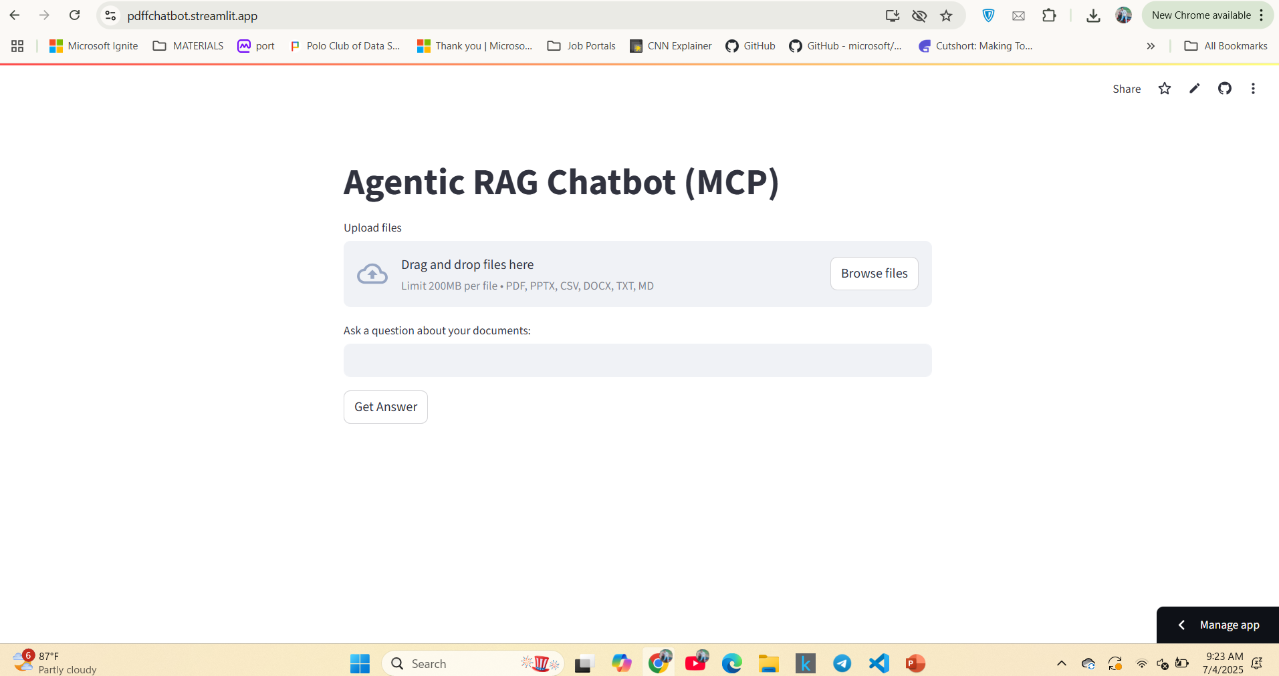
UI screenshots of Working app

Slide 6
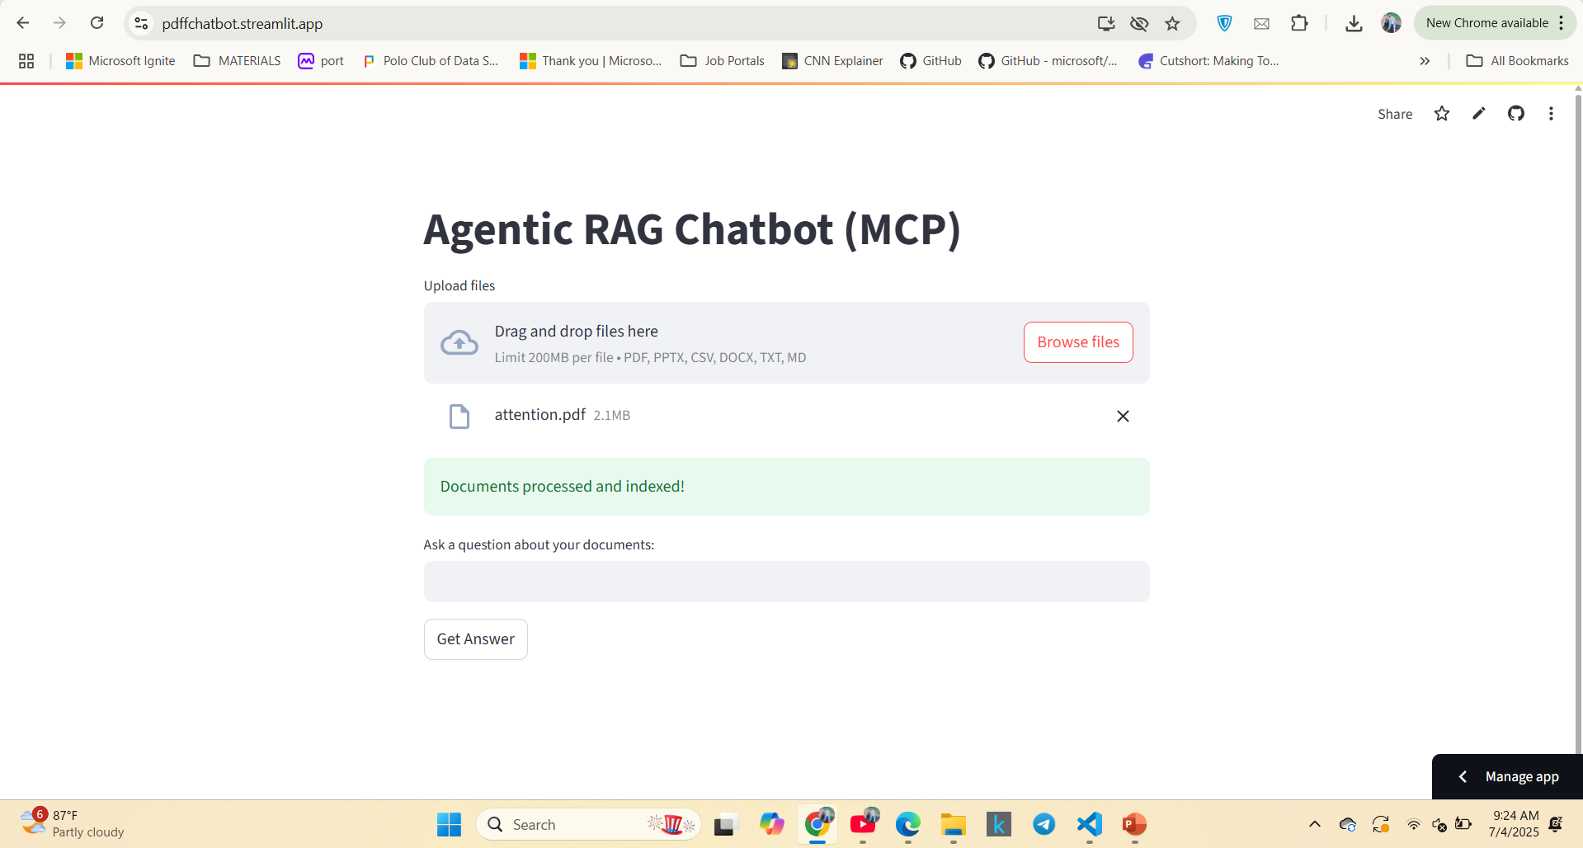

Slide 7
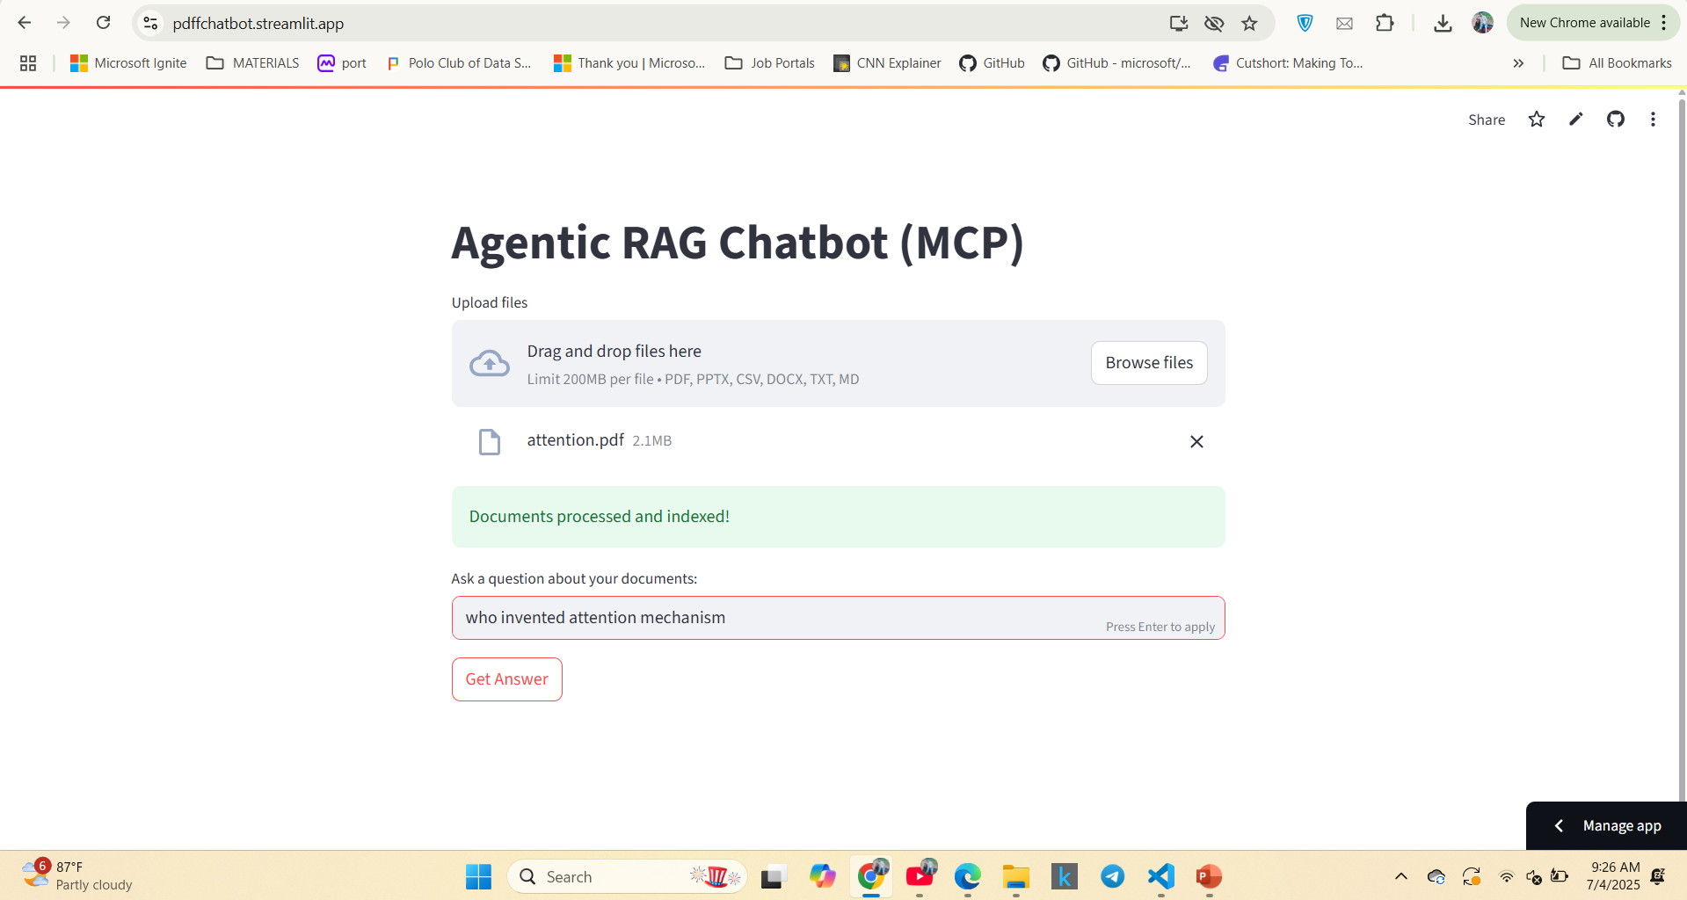

Slide 8
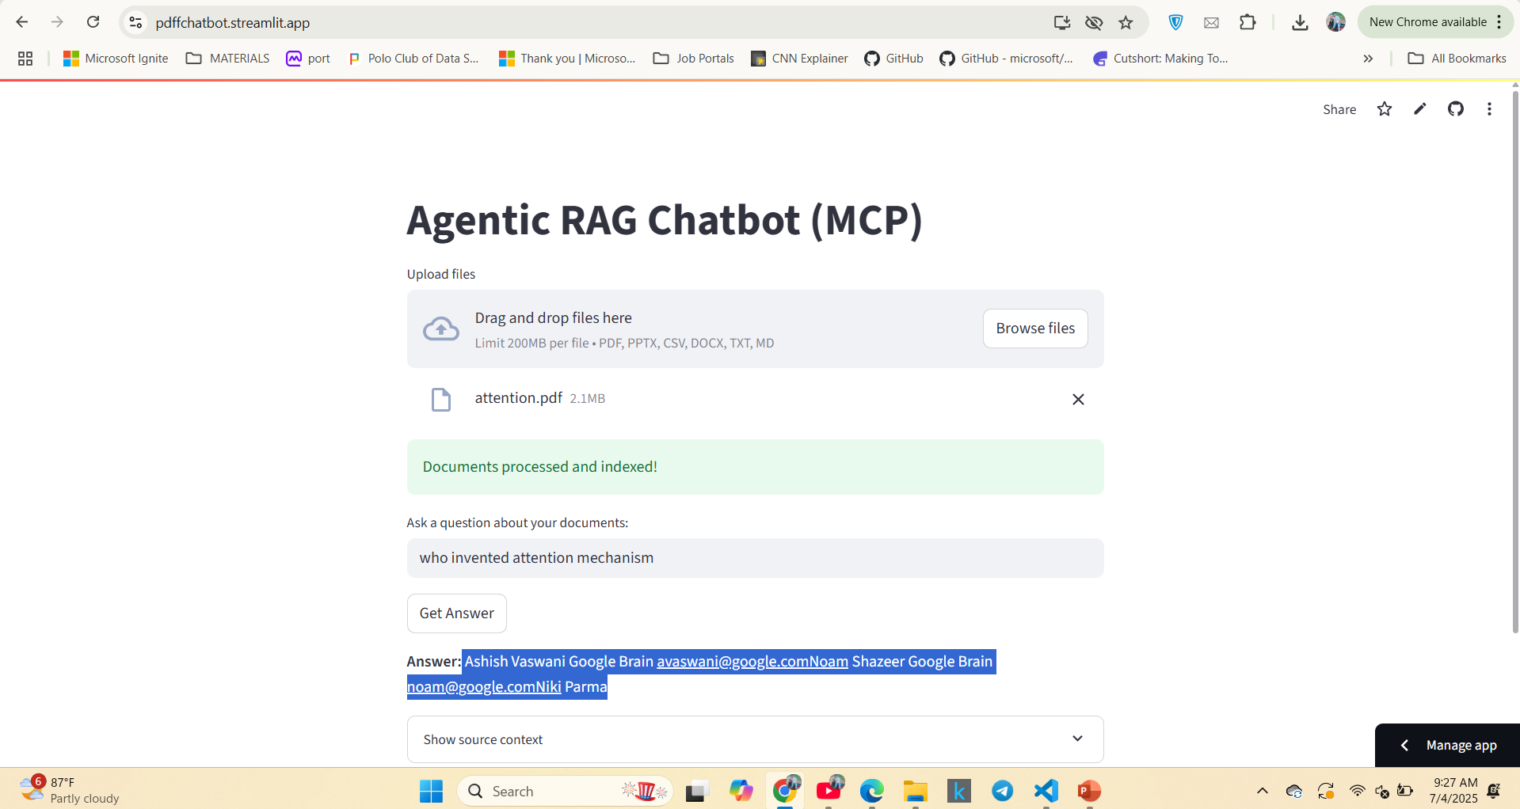

Slide 9
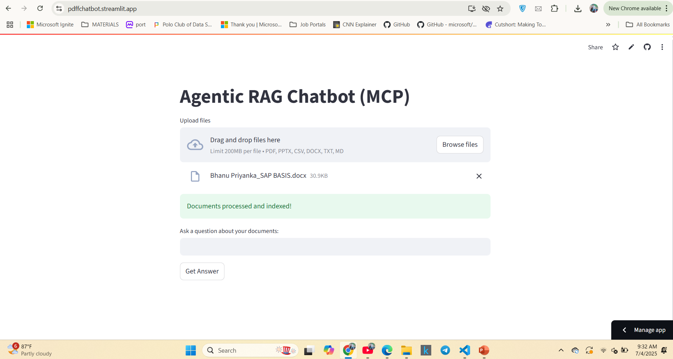
UI screenshots of Working app in DOCS Format

Slide 10
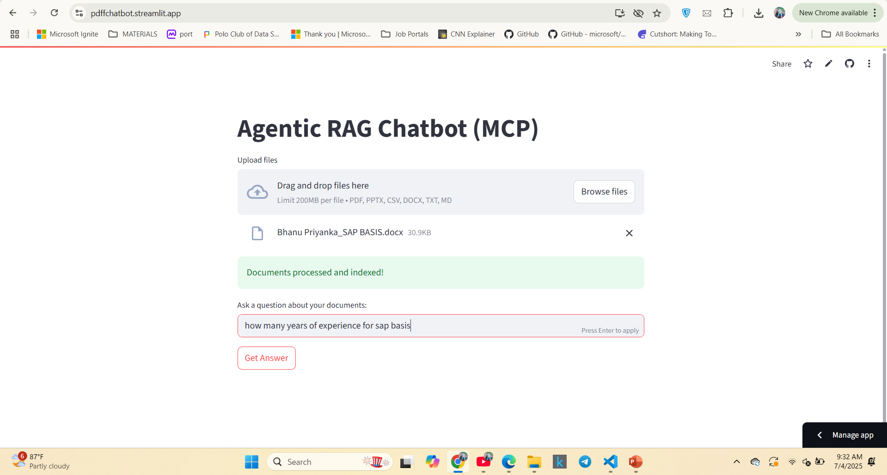

Slide 11
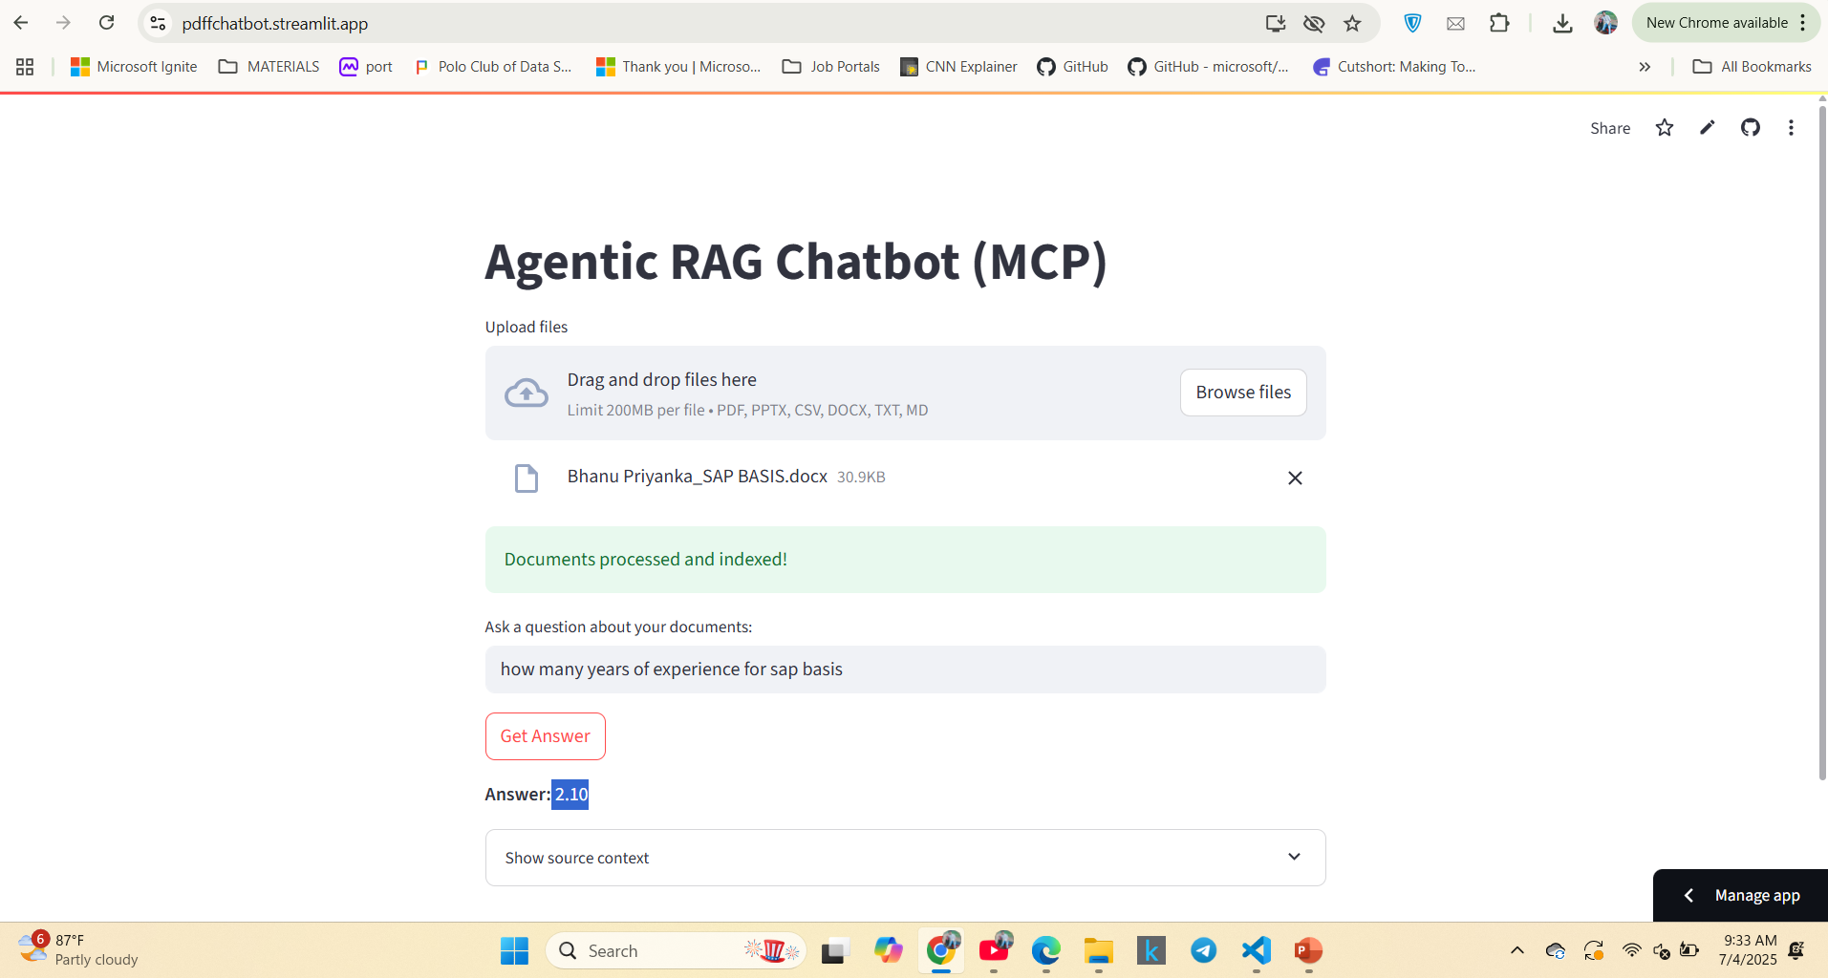

Slide 12
Agent design components
Tech Stack Used
The modular agent design of the chatbot consists of three main components: the Ingestion Agent for document parsing, the Retrieval Agent for semantic search through a vector store, and the LLM Response Agent for generating responses based on the retrieved context. Each agent operates independently while communicating via structured MCP messages.
Component Technology
------------------ ---------------------------------------------
UI Streamlit
Document Parsing PyPDF2 / pypdf, python-docx, python-pptx, pandas
Embeddings Sentence Transformers (all-MiniLM-L6-v2)
Vector Store FAISS (in-memory)
LLM Hugging Face Transformers (flan-t5-base)
Agent Protocol Custom MCP (Python)

Slide 13

Message passing with MCP
The Model Context Protocol (MCP) facilitates structured communication between agents within the RAG chatbot. Each message contains essential elements, such as sender, receiver, type, trace_id, and payload. This structure ensures clear and traceable interactions among the Ingestion, Retrieval, and LLM Response Agents, enhancing modularity and debuggability within the architecture.

Slide 14

02
Challenges and Improvements

Slide 15
Memory management for LLMs
One of the significant challenges faced is managing memory limits for local large language models (LLMs). Prompt and context truncation can hinder the chatbot's ability to provide coherent and comprehensive responses, necessitating strategies to optimize memory usage while maintaining performance.
Managing dependencies for cloud deployment (Streamlit, FAISS, Transformers).

Slide 16

Support for multiple document formats
Another challenge involves supporting various document formats, including newer or less common types. Addressing encoding issues and ensuring seamless integration across formats is crucial for providing users with a reliable and versatile question-answering experience.

Slide 17
Future enhancements and features
Future improvements will focus on expanding the range of supported file types, such as XLSX and HTML, as well as integrating with cloud-hosted LLMs for enhanced performance. Additional features may include user authentication, document privacy measures, and an improved user interface for managing files and conversation history.

Slide 18
Conclusions
In summary, the Agentic RAG Chatbot demonstrates a robust approach to semantic document question answering through its agent-based architecture and effective use of MCP. While challenges in memory management and format support exist, future enhancements promise to elevate both functionality and user experience.

Slide 19
Thank you!
Do you have any questions?
+00 000 000 000

